Slide 1




NEXT GEN EMPLOYABILITY PROGRAM
Creating a future-ready workforce
Team Members
College Name
Student Name : ALLEN CHRISSO DHAS V
Student ID :au311121205008
NM ID: AB6505C40370EDDB6004A918DEEBC4AE
LOYOLA-ICAM COLLEGE OF ENGINEERING AND TECHNOLOGY

Slide 2

CAPSTONE PROJECT SHOWCASE
Project Title
MUSIC WEB APPLICATION USING DJANGO FRAMEWORK
Abstract | Problem Statement | Project Overview | Proposed Solution | Technology Used | Modelling & Results | Conclusion

Slide 3
Abstract
Built on Django, our music player web app offers users a platform to discover, organize, and play their favorite tunes. With a sleek interface, it enables seamless navigation, playlist creation, and playback controls. Users can register accounts, login securely, and personalize their music experience. Leveraging Django's robust backend, it ensures efficient data management and smooth integration of user interactions. Whether exploring new tracks or revisiting old favorites, our app provides an immersive and enjoyable listening journey.
Source :

Slide 4
Problem Statement
Develop a web application using Django framework for a music player that allows users to create accounts, log in securely, browse a collection of music tracks, and play them. The application should include features such as search functionality, playlist creation, playback controls (play, pause, skip), and volume adjustment. Ensure a user-friendly interface, efficient data management, and seamless integration of user interactions to provide an enjoyable music listening experience.
Source :

Slide 5
Project Overview
Create a Django-based music player web application that enables users to discover, manage, and listen to music tracks. The app will offer user registration and authentication functionalities for secure access. Users can browse through a catalog of songs, search for specific tracks, create personalized playlists, and control playback features such as play, pause, skip, and volume adjustment. The application will provide a seamless and intuitive user interface, ensuring an enjoyable music listening experience for all users.
Source :

Slide 6
Proposed Solution
.
The proposed solution is to develop a Django-based music player web application that integrates user authentication, music track management, and playback functionalities. Users will be able to register accounts securely, log in to access their personalized music library, and explore a wide range of tracks available in the database. The application will feature a user-friendly interface with intuitive navigation and search capabilities for easy discovery of songs. Users can create playlists, add tracks to their favorites, and control playback options such as play, pause, skip, and volume adjustment. Leveraging Django's robust framework, the application will ensure efficient data management, seamless integration of user interactions, and optimal performance for a smooth music listening experience.
Source :

Slide 7


Technology Used
Front-end
Back-end
Source :

Slide 8
Modelling & Results
Modeling:
Utilize Django framework for building the web application, employing its built-in features for user authentication and database management.
Define data models such as User, Song, and Playlist using Django's ORM to represent users, music tracks, and user playlists respectively.
Results:
Users can register accounts, log in securely, and access their personalized music libraries.
The application offers a searchable catalog of songs, enabling users to discover new music easily.
Users have the ability to create custom playlists, add songs to favorites, and manage their music collection efficiently.
Source :

Slide 9
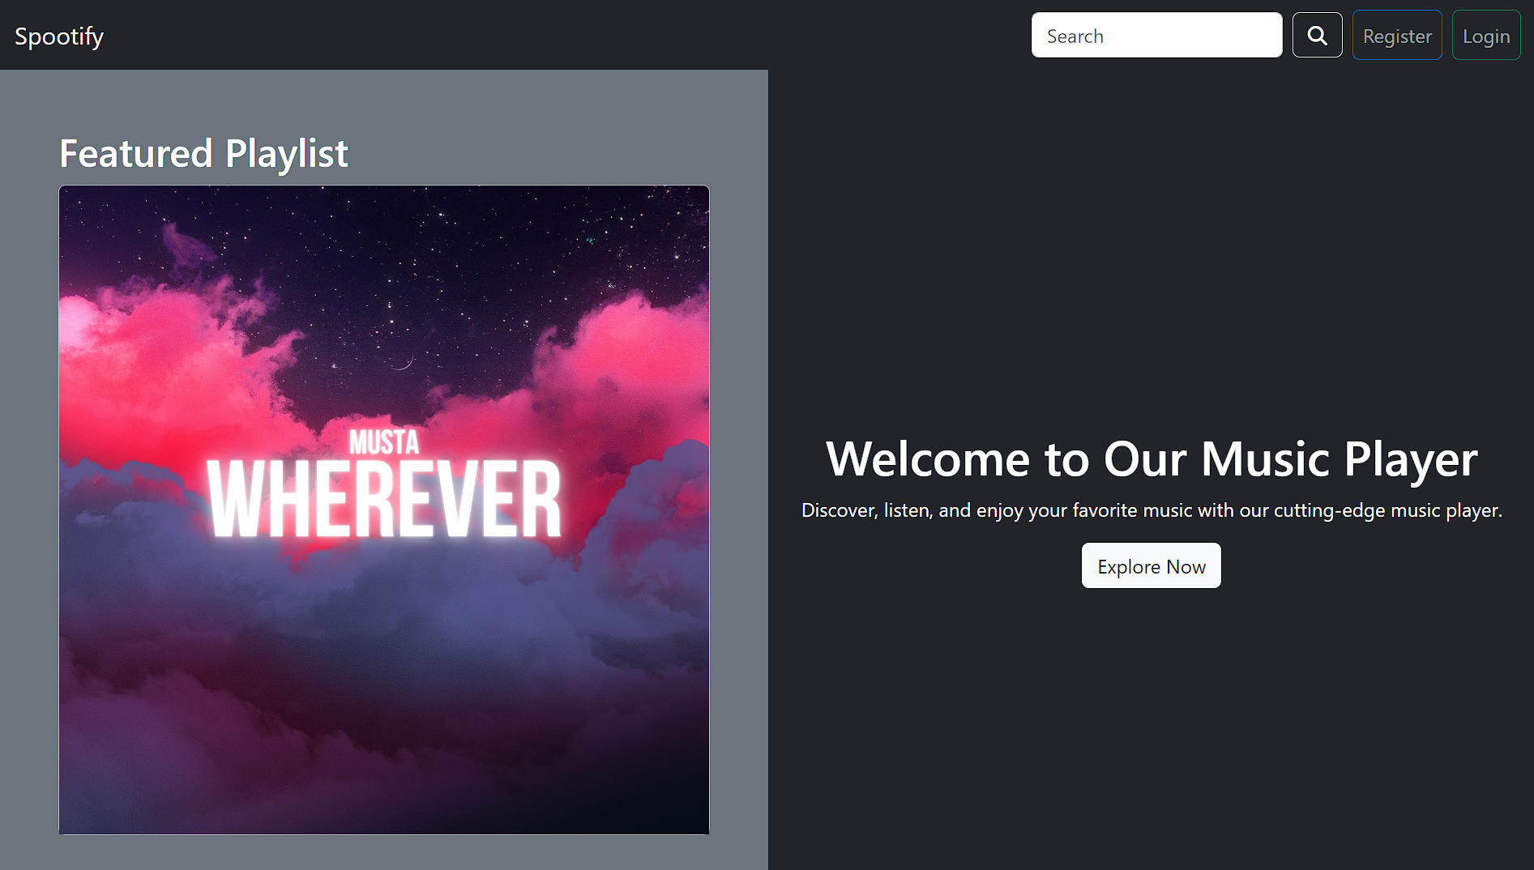
Homepage

Slide 10
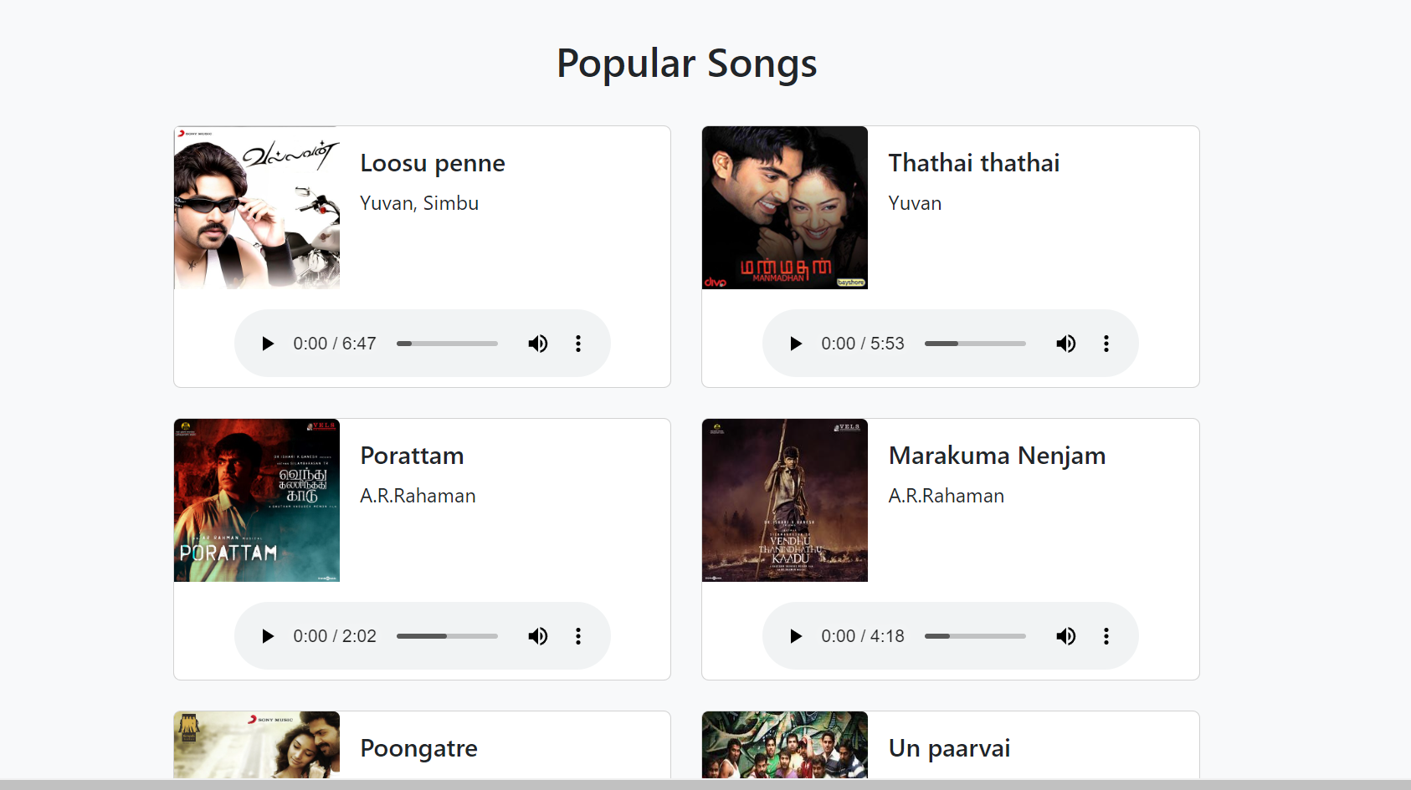
Popular songs

Slide 11
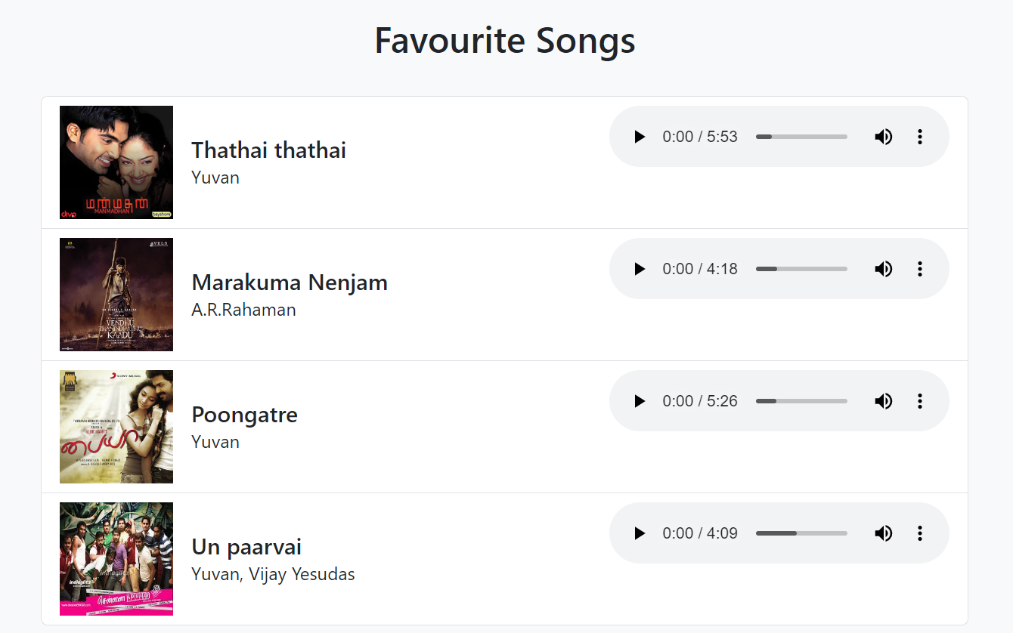
Favourite Songs

Slide 12
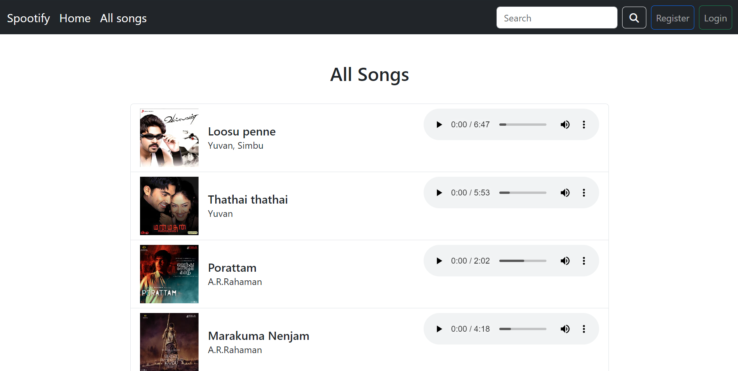
All Songs Page

Slide 13
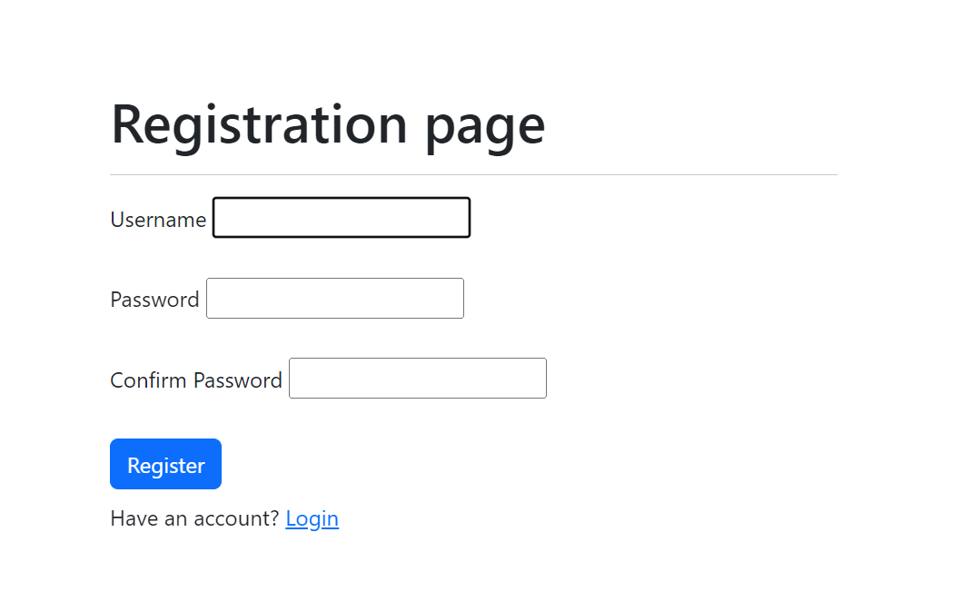
Registration Page

Slide 14
Future Enhancements:
Social Sharing: Implement functionality for users to share their favorite songs or playlists on social media platforms, enhancing user engagement and expanding the application's reach.
Recommendation System: Integrate a recommendation engine to suggest personalized playlists or songs based on user preferences, listening history, and trends, enhancing the discovery of new music.
Advanced Playback Features: Enhance the playback experience by adding features such as shuffle mode, repeat mode, equalizer settings, and lyrics display, providing users with more control and customization options.

Slide 15
Conclusion
In conclusion, the Django-based music player web application offers users a convenient and enjoyable platform for accessing and managing their music collection. By leveraging Django's powerful features for user authentication, database management, and ORM, we've created a robust system that provides users with personalized music experiences. With features such as user registration, authentication, search functionality, playlist management, and playback controls, the application meets the diverse needs of music enthusiasts. The responsive design and intuitive interface ensure a seamless user experience across devices. Overall, this project demonstrates the versatility and efficiency of Django in developing web applications tailored to specific domains like music streaming.
Source :

Slide 16
The End
Notes:
Thank You !!

